Slide 1
R Programming Course
5. Programming Concepts

Slide 2
R Programming Course
5.1 Programming Concepts
R is a computer language which is processed by a special program called an interpreter.
This program reads and evaluates R language expressions, and prints the values determined for the expressions.
The interpreter indicates that it is expecting input by printing its prompt at the start of a line.
By default, the R prompt is a greater than sign >.

Slide 3
R Programming Course
5.1 Programming Concepts - continued
R can be used as a Calculator
For grouping and evaluation. normal arithmetic rules apply; multiplication and division occur before addition and subtraction.
Operator precedence
Operator | Description
^ | Exponentiation
- + | unary minus and plus
: | sequence operator
%/% %% | integer division, remainder
* / | multiplication, division
+ - | addition, subtraction
Evaluation of equal precedence takes place left-to-right (except for exponentiation, which takes place right-to-left)

Slide 4
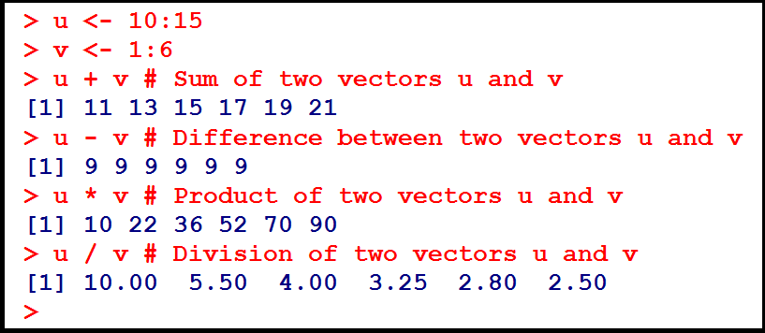
R Programming Course
5.2 Vectorized calculations
Element-wise Operations on Vectors
Suppose we have a function f() that we wish to apply to all elements of a vector x.

Slide 5
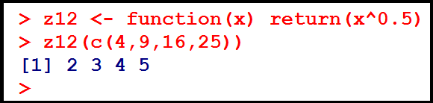
R Programming Course
5.2 Vectorized calculations - continued
Element-wise Operations on Vectors – continued.
In many cases, we can accomplish this by simply calling f() on x itself.

Slide 6


R Programming Course
5.2 Vectorized calculations - continued
Filtering
Here is what happened: We asked R to find the indices of all the elements of z whose squares were greater than 20, then use those indices in an indexing operation on z, then finally assign the result to w.
We may just want to find the positions within z at which the condition occurs. We can do this using which():

Slide 7
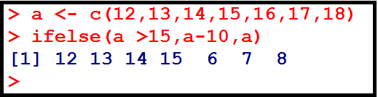
R Programming Course
5.2 Vectorized calculations - continued
Filtering
The form is ifelse(b,u,v) where b is a boolean vector, and u and v are vectors.
The return value is a vector, element i of which is u[i] if b[i] is true, or v[i] if b[i] is false.

Slide 8
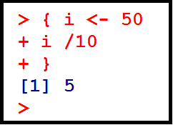
R Programming Course
5.3 Control structures
Computation in R consists of sequentially evaluating statements.
Statements, such as x <- 10:100 or mean(x), can be separated by either a semi-colon or a new line.
Statements can be grouped together using braces '{' and '}'. A group of statements is called a block. Single statements are evaluated when a new line is typed at the end of the syntactically complete statement.

Slide 9
R Programming Course
5.3 Control structures - continued
The following are the basic control-flow constructs of the R language:
They function in much the same way as control statements in any programming language.
a. Statements that perform testing that shifts flow
1. if statements
2. switch statements
b. Statements that perform / control looping
1. for
2. while
3. repeat
4. break
5. next

Slide 10
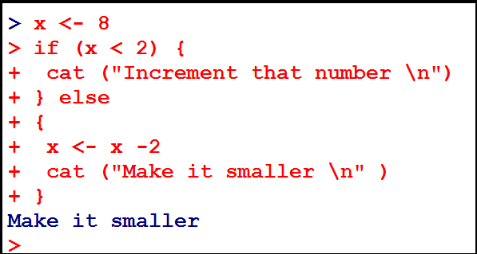
R Programming Course
5.3 Control structures - continued

Slide 11
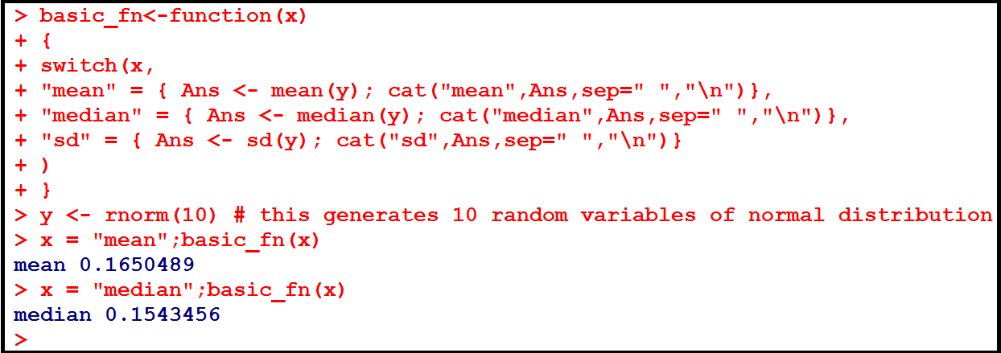
R Programming Course
5.3 Control structures - continued

Slide 12
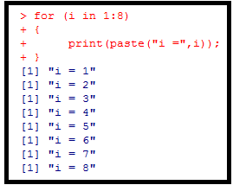
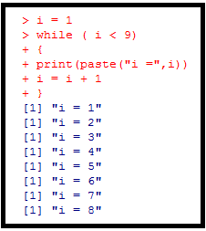
R Programming Course
5.3 Control structures - continued

Slide 13
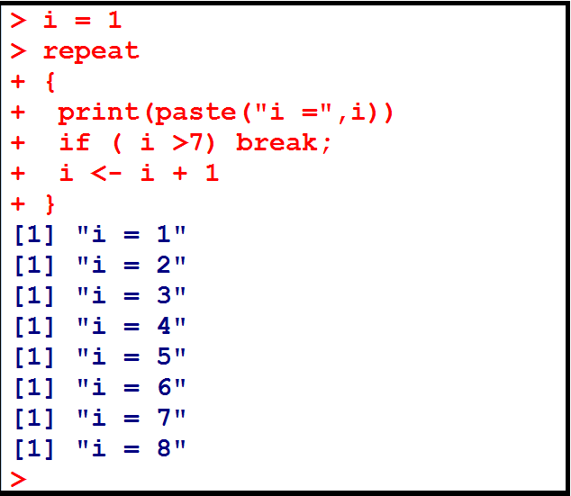
R Programming Course
5.3 Control structures - continued
The break statement breaks out of a for, while or repeat loop.

Slide 14
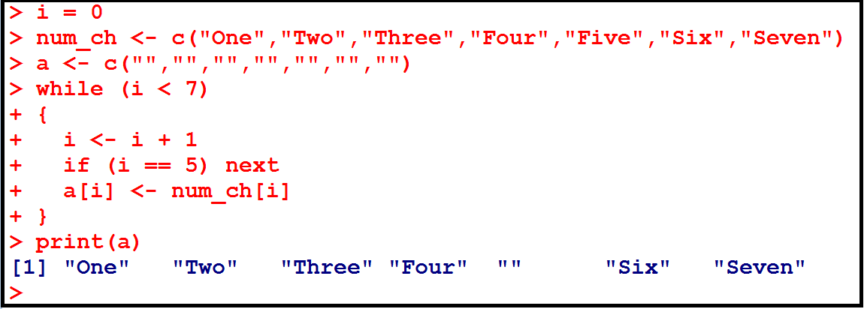
R Programming Course
5.3 Control structures - continued
The next statement halts the processing of the current iteration and advances the looping index.

Slide 15
R Programming Course
5.4 Scoping rules
The symbols which occur in the body of a function can be divided into three classes:
formal parameters
local variables
free variables
The formal parameters of a function are those occurring in the argument list of the function.
Their values are determined by the process of binding the actual function arguments to the formal parameters.

Slide 16
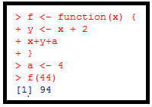
R Programming Course
5.4 Scoping rules - continued
Local variables are those whose values are determined by the evaluation of expression in the body of the functions.
Variables which are not formal parameters or local variables are called free variables.
In this function, f
x is a formal parameter,
y is a local variable and
a is a free variable

Slide 17
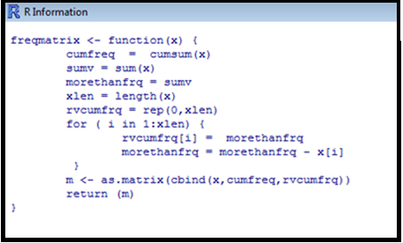
R Programming Course
5.5 Writing functions
The syntax for writing a function is
function (arglist) body

Slide 18
R Programming Course
5.5 Writing functions - continued
The first component of the function declaration is the keyword function which indicates to R that you want to R that you want to create a function.
An argument list is a comma separated list of formal arguments. A formal argument can be a symbol, a statement of the form ‘symbol = expression’, or the special formal argument ‘....’.
The body can be any valid R expression. Generally, the body is a group of expressions contained in curly braces ‘{‘ and ‘}’.

Slide 19
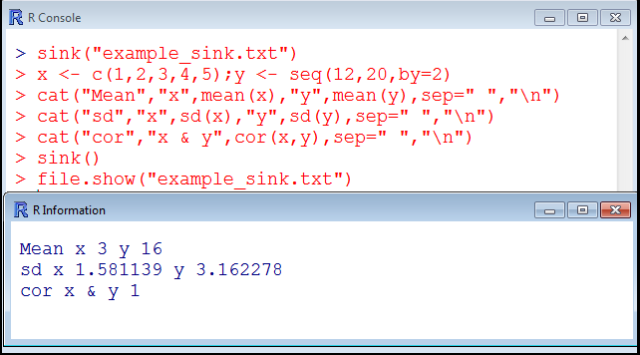
R Programming Course
5.6 Directing console output to a file
sink(file) diverts R output to a connection; where file is a writable connection or a character string naming the file to write to, or NULL to stop sink-ing.
The command file.show displays one or more files.

Slide 20
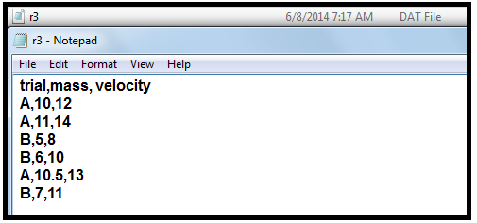
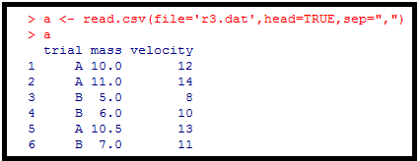
R Programming Course
5.7 CSV / fixed-width file operations
The following command will read in the data and assign it to a variable called “a”.
Note: Last line in r3.dat is a blank line.

Slide 21
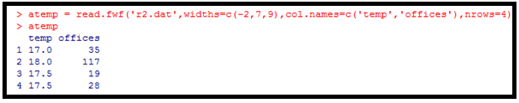
R Programming Course
5.7 CSV / fixed-width file operations - continued
Fixed width file
Here, the data is organized in flat files and delimited at preset locations on each line.
The command to deal with these kind of files is read.fwf.
File contents of r2.dat
1 17.000000035
2 18.000000117
3 17.500000019
4 17.500000028
<blank line>

Slide 22
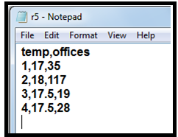
R Programming Course
5.7 CSV / fixed-width file operations - continued
The function write.table writes file, an object typically a data frame but this could well be another kind of object vector, matrix,…).

Slide 23
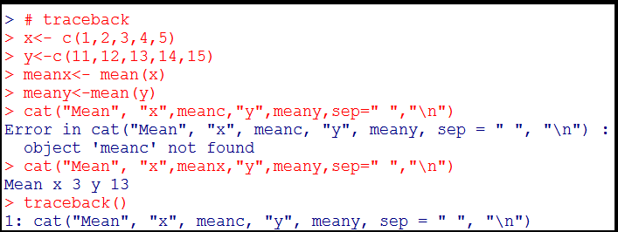
R Programming Course
5.7 Debugging
Let us make a mistake in the following R script, by replacing meana with meanc, which is non-existent.
The traceback() function prints call stack, the list of functions which were called before the error occurred.

Slide 24

R Programming Course

Slide 25
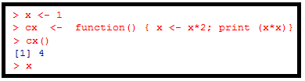
R Programming Course
The following R code changes the value of its argument inside the function. What it is the value of x after running the below piece of R code:
4
2
1
None of the above

Slide 26

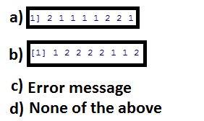
R Programming Course
The output after running the following R code is

Slide 27
R Programming Course
c)
b)

Slide 28

R Programming Course

Slide 29
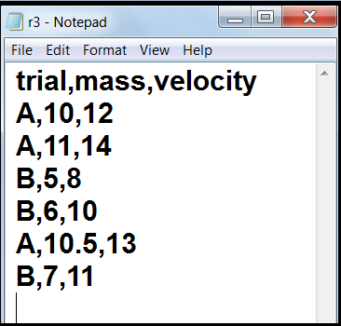
R Programming Course
Lab Exercise 1:
Read the csv type file with name “r3.dat” into an object a and print its contents.
The file r3.dat and available in your local drive under the folder R_data.

Slide 30
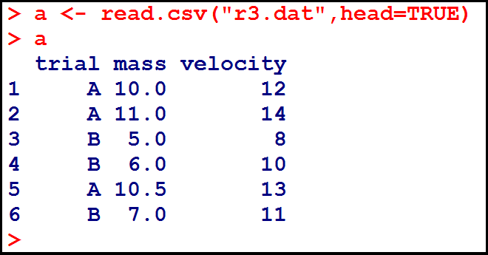
R Programming Course
Lab Exercise 1 - continued:
The command to read the data file is read.csv.
The first argument is the name of the file.
The second argument indicates whether or not the first row is a set of labels.

Slide 31
R Programming Course
Lab Exercise 2:
Assume you are processing the examination results of the BTech - IT students.
You have the Roll number, name, marks (max=100) in each of the five exam papers.
You declare the result as "pass", if the student gets not less than 50 in each paper; if the student gets less than 50 marks, the result is "fail".
Print a tabulated mark register containing the following details:
1. Serial Number
Roll number
Name of the student
4. Marks obtained in each of the five exam papers
5. Result

Slide 32
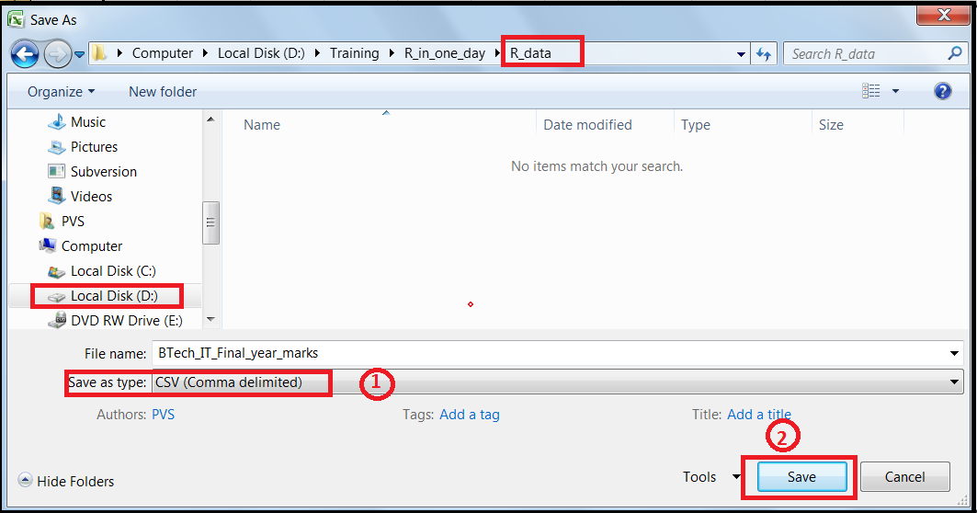
R Programming Course
Lab Exercise 2- continued:
The file “Btech_IT_Final_year_marks” is an excel file containing the data.
Convert the same to a csv file as follows:

Slide 33

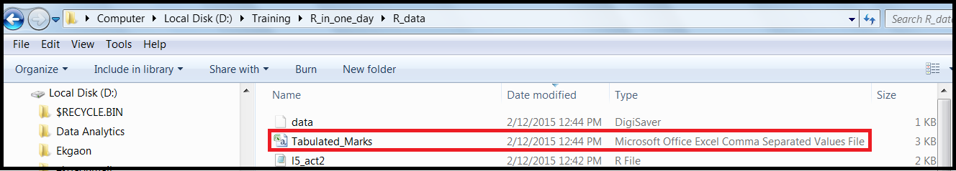
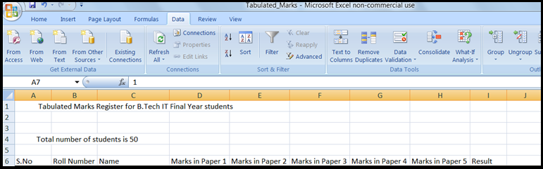
R Programming Course
Lab Exercise 2- continued:

Slide 34
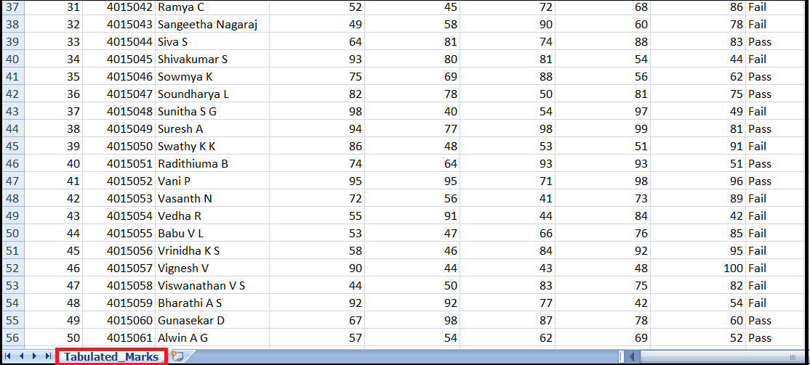
R Programming Course
Lab Exercise 2- continued:

Slide 35
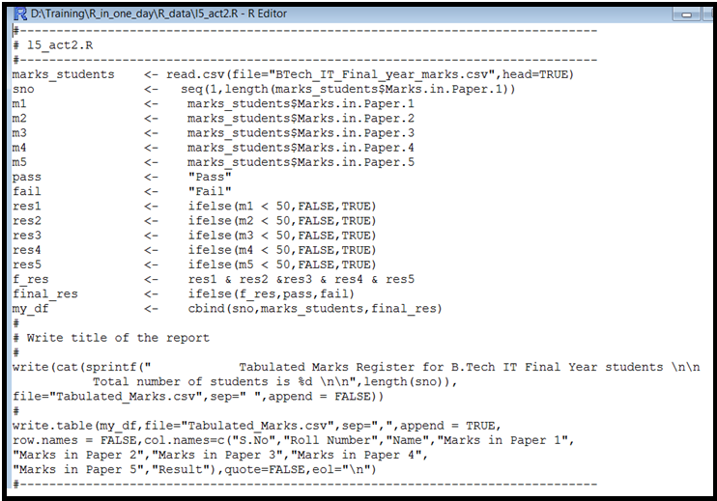
R Programming Course
Lab Exercise 2- continued:

Slide 36
R Programming Course
Activity 1:
Refer to the file
“U05_R Programming_v1.2.pdf“

